Slide 1
ECOSYSTEM SERVICES
Greg Huggins
DWA CORPORATE IDENTITY
Presented by:
Johan Maree
Deputy Director: Media Production
12 December 2012

Slide 2
Ecological Goods & Services Attributes (EGSA)
EGSA are the goods and services provided by the river (and associated ecological systems) that result in a value being produced for consumers. EGSA are now referred to as Ecosystem Services.
Provisioning services are the most familiar category of benefit, often referred to as ecosystem ‘goods’, such as foods, fuels, fibres, medicine, etc., that are in many cases directly consumed.
Other services include
cultural services (ritual use of rivers, aesthetic or historical importance)
regulating services (e.g. water quality inputs), and
supporting services (e.g. nutrient formation)

Slide 3
Socio and Rural Economics
Brief in this study is to look at two separate components (packages)of the overall “Socio-Economics” but to integrate in final analysis.
Package 1- Economics linked to market and broader economic parameters
Package 2 – Ecosystem Goods and Services/Ecological Goods and Services Attributes (EGSA), Ecological Infrastructure = Ecosystem Services

Slide 4
Socio and Rural Economics
Our approach:
Water abstracted from the river and utilised/value added falls within the ambit of “economics”
Water that remains in the river but provides goods/services that generate value falls within the ambit of “Ecosystem Services”

Slide 5
SCENARIO CONSEQUENCES: ASSESSMENT STEPS
STEP 1
STEP 2
Analyse the site – status quo.
Identify the communities likely to derive benefits from ESS
List the range of ESS available
Populate Ecosystem list and generate spreadsheet

Slide 6
SCENARIO CONSEQUENCES: ASSESSMENT STEPS
STEP 3: EVALUATE CHANGE PER SC
STEP 4: AGGREGATE THE STEP
ID the potential change that each of the key ESS may undergo in each of the scenarios.
Change is measured against a base score of 1 –represents the current situation.
The potential change will be noted as a factor, EG, no change = 1, a 50% increase = 1.5, and a 20% decrease = 0.8.
Each category rated out of 1
Sum the numbers of each service, divide by number of services, and rate each service out of 1

Slide 7
SCENARIO CONSEQUENCES: ASSESSMENT STEPS
STEP 5 WEIGHTING
STEP 6 REACH WEIGHTING
Weigh each category
Category weight is normalised to 1
E.g. all services equal weight then Provisioning = 0.25, Regulating = 0.25, Cultural = 0.25, Supporting = 0.25.
The SCI score generated as first steps in determine reach importance revisited.
Score out of 5 - acts as weighting - normalised back to a score of “1”

Slide 8
Results

Slide 9
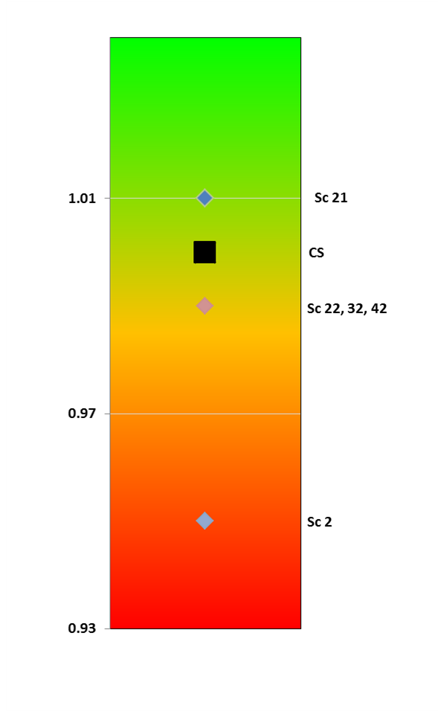
MKOMAZI CONSEQUENCES
Abundance of some importance fish sp decrease under some scenarios (eg yellow fish).
Riparian veg: Minor increase in some woodies. Mostly no change in utilisation. Sc 2 – most impact.
WQ: No change except waste assimilation.
Geomorph: Mostly no change as river deeply incised with few floodplains.
Estuary – possible impacts on some sc, especially 2, related to water quality, recreation, fishing

Slide 10
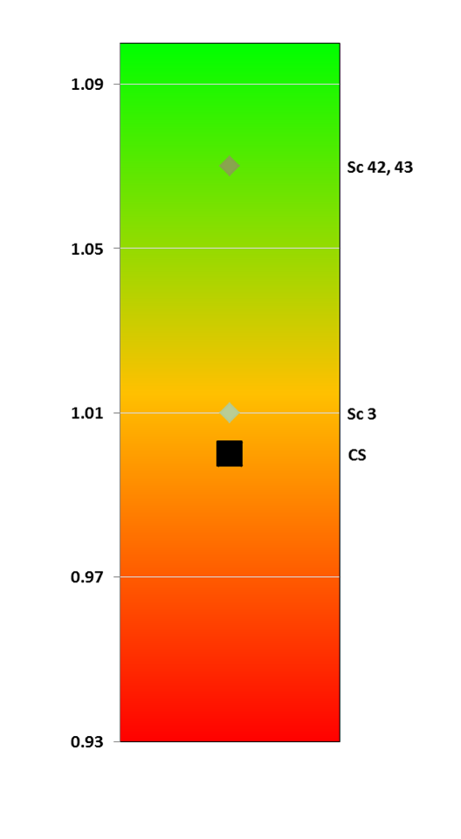
MVOTI CONSEQUENCES
Abundance of some importance fish sp decrease under some scenarios (eg yellow fish).
Riparian veg: Some increase in abundance in reeds, sedges etc in some scenarios, mostly no change
WQ: No change except for Sc 3 – potential for disease.
Geomorph: Reduced base flows and floods – flood attenuation, improvement of floodplain cultivation, etc – small increase in utilisation

Slide 11
CONCLUSIONS
Changes are small at the Mkomazi and negative. I.e., although the utilisation is important, scenarios have minor impact on ESS.
Utilisation in the Mvoti mostly no change or very small improvements.
Weighting must still be included.
Estuary analysis must still be undertaken.
Doubtful whether any significant changes of this estimate.

